Slide 1

KALERWE
S.D.A Hymnal 618
4 ~ Verses
100.
Yimirira Ne Yesu.…
~
Stand up, Stand up, for Jesus…

Slide 2

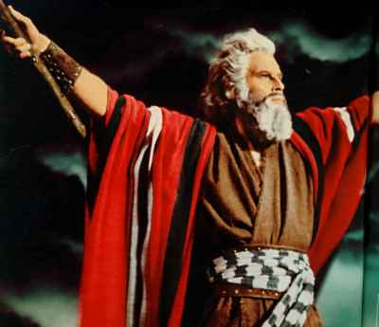
p
1 of 4 verses
Yimirira ne Yesu,
Ggwe omulwanyi we
Yimusa (e)bendera ye,
so togissa wansi!
Mu ntalo zaffe zonna, Atukulembere
Awangul(e) omulabe,
Ye abe Kabaka

Slide 3
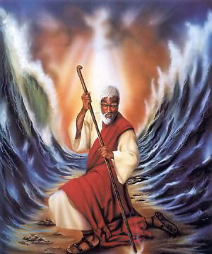
2 of 4 verses
Yimirira Yesu,
E’ngoma erawa
Olutalo lunene,
Golokoka mangu!
Abantu be, mulwane,
(A)balabe bangi nnyo,
kale muddemu (a)manyi,
Tujja kuwangula

Slide 4
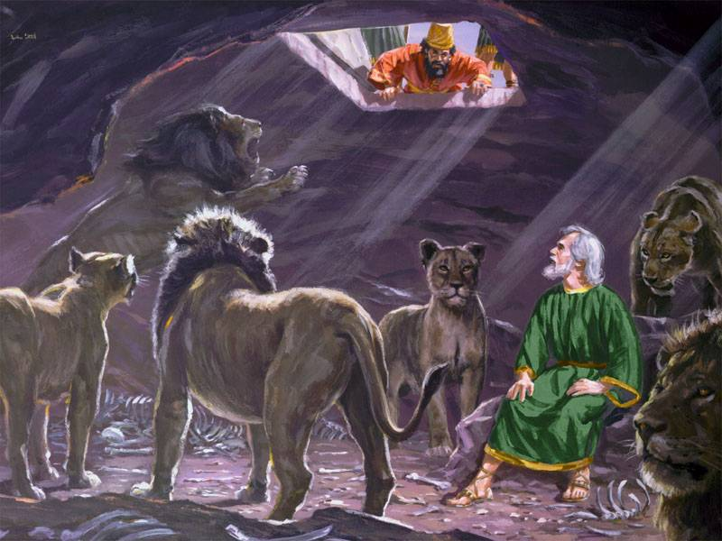
3 of 4 verses
Yimirira ne Yesu,
Wesige (a)maanyi ge,
Ggwe oli munaffu nnyo,
Wesige ye yekka!
Mu maanyi g’enjiri ye,
Wamu n’okusaba,
Mu buli kabi konna,
Lwaniranga mu ye.

Slide 5
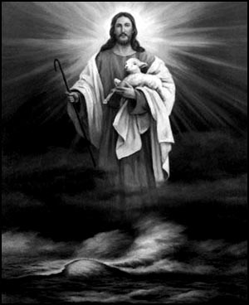
4 of 4 verses
Yimirira Yesu,
(O)lutalo terulwe,
Olwa leero kulwana
Enkya buwanguzi
Awangul(a) aliweebwa, Engul(e) ey’obulamu,
Alifuga ne Yesu,
Emirembe gyonna.

